Slide 1

ENGG404 – Lecture Chapter 7.4: Leadership Models – Applying the Principles of Human Motivation to Lead Safety
Fundamentals of RM
RM System and Process
Leadership in RM
Incident Investigation
RM Tools & Challenges
RM in Industry
People & Org.
Applications & Perspectives
On Becoming a leader in Risk Management
Note to Students: The Student’s Version of this PPT contains more slides and information than is presented in the lecture.
It is expected that you understand this information in order to give you a base of understanding for other topics in this lecture.

Slide 2
Learning Outcomes
Apply basic principles and practices of human motivation theories in managing human behaviours to minimise human error and achieve safe work places.
Two models – why and how human behaviours are addressed:
Model 4: The Swiss Cheese Model
Model 2: The Role of Line Management
Three models to manage behaviours and motivate people:
Model 1: The Attitudes Model
Model 3: The ABC Model
Model 5: The Abilities Model
We want to equip you with some tools for managing and leading people!
Chapter 7.4: Applying the Principles of Human Motivation

Slide 3
Causes of Incidents – At-Risk Behaviours and Human Errors:
Human error constitutes a significant threat to safety and risk management in any industry.
Think back to some “error” that you made that resulted in some kind of “loss incident”. What did you “blame”?
Chapter 7.4: Applying the Principles of Human Motivation

Slide 4
Key Points to Consider:
Where technology stops, human activity takes over.
Human error is more likely at interphases (between activities, cross shifts, processes, equipment, etc.)
Human errors can be classified as basic causes caused by weaknesses in the risk management system elements
Immediate causes (why did that SP occur?)
Basic causes:
Personal – improper motivation
Job – inadequate training
E&D – inadequate ergonomic design
Latent causes (related to an RME)
Address latent causes … human errors are mitigated.
The goal is to find and eliminate latent causes, NOT terminate employees.
Chapter 7.4: Applying the Principles of Human Motivation

Slide 5
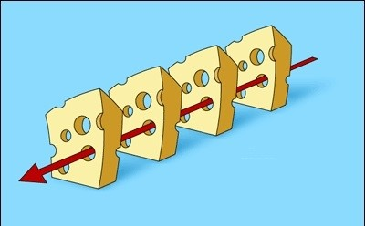
Recall The Swiss Cheese Model of a Loss Incident!
Recall the “Slices of Cheese” in the Model: A loss incident will occur when humans make errors (#4) in presence of latent causes (#1): 1) Risk Management System Elements; 2) Engineering Controls; 3) Administrative Controls; 4) Work Practices
The Swiss Cheese Model is not a means to modify human behaviour, but to explain the relationship between human errors and loss incidents, and explain WHY we must address human behaviours.
1
2
Planned activity and its hazards & risks
3
4
D
Loss Incident
Chapter 7.4: Applying the Principles of Human Motivation

Slide 6
Model 4: The Swiss Cheese Model & Interrelation of Latent Causes & Human Errors
Why focus on behaviours?
Sub-standard work practice at #4 is the result of:
not knowing what to do, or
an intentional decision to NOT meet expectations (i.e. purposely not follow procedures), or
simple human error, or
Basic causes (engineering & design factors, job factors, etc.)
1
2
Planned activity and its hazards & risks
3
4
D
O
Loss Incident
Chapter 7.4: Applying the Principles of Human Motivation

Slide 7
Model 4: The Swiss Cheese Model & Interrelation of Latent Causes & Human Errors
Why focus on behaviours?
Conversely, a loss incident could be prevented simply by purposeful and intentional action by a worker.
In other words, the worker knows the systems have failed, but has adjusted or adapted their work practices to overcome the deficiencies.
Still a significant risk management concern!
1
2
Planned activity and its hazards & risks
3
4
D
Successful outcome
Chapter 7.4: Applying the Principles of Human Motivation

Slide 8

Model 4: The Swiss Cheese Model & Interrelation of Latent Causes & Human Errors
Why focus on behaviours?
Or that the worker knows critical parts of the system must always be working, and therefore is personally motivated to ensure those critical parts are always working …
… because the worker knows something bad will happen if these critical parts of the system fail.
The account of “George” in the Hub Oil Seminar.
1
2
Planned activity and its hazards & risks
3
4
D
Successful outcome
Chapter 7.4: Applying the Principles of Human Motivation

Slide 9
Model 4: The Swiss Cheese Model & Interrelation of Latent Causes & Human Errors
Why focus on behaviours?
We can significantly reduce the likelihood of a loss incident by addressing the latent causes with a RMS/RMP that is robust to human error.
With human action reduced (or eliminated), human error is substantially reduced, if not eliminated.
1
2
Planned activity and its hazards & risks
3
4
D
Successful outcome
Chapter 7.4: Applying the Principles of Human Motivation

Slide 10
Model 4: The Swiss Cheese Model & Interrelation of Latent Causes & Human Errors
Eliminate Human Error – Theory or Reality?
What is the next wave of technology that aims to eliminate human error?
Artificial Intelligence! … and that opens an entirely new field in risk management!
1
2
Planned activity and its hazards & risks
3
4
D
Successful outcome
Chapter 7.4: Applying the Principles of Human Motivation

Slide 11
Theories of Human Motivation in the Workplace:
Key questions:
What really motivates a person to do a good – and safe – job?
How do leaders motivate their workers to do a good and safe job?
What are the best and most effective practices to achieve this?
The best leaders encourage their employees to:
Contribute to a safe and successful workplace
Identify with the organization’s performance
Own the results achieved
Showcase their abilities and skills on a daily basis
They do this by providing employees with intrinsic rewards:
Positive feedback
Technical support with resources
Emotional and cultural support
A positive work environment
Extrinsic rewards can backfire in terms of motivation, depending on the situation e.g. a bonus tied to fewer LTI’s, near misses
Chapter 7.4: Applying the Principles of Human Motivation

Slide 12
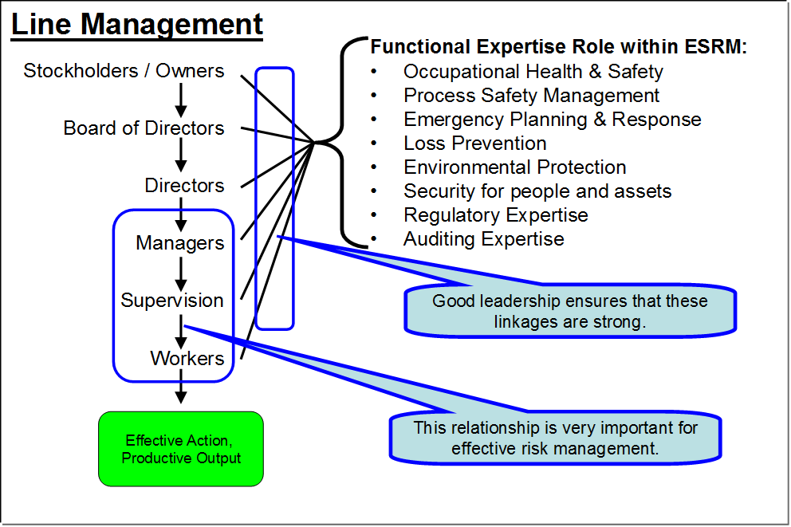
Model 2: The Role of Line Management in Addressing At-Risk Behaviours
Recall Sub-standard Practices = At-Risk Behaviours
A person’s behaviour is related to their level of motivation.
Relationships between front-line workers and supervisors / managers is most important for managing behaviours.
Front-line workers must be well supported by good leadership!
Recall the relationships between “You and Your Supervisor” and between “You and the People You Supervise”.
Workers: Directly exposed to risks, and responsible for managing those risks!
Chapter 7.4: Applying the Principles of Human Motivation

Slide 13
Why Study Human Error, and Motivation, etc.?
Addressing “people problems” is challenging because:
We have not been taught how to handle these issues.
We have not been taught why it is imperative to handle.
It is a challenge to:
Coach effectively
Intervene effectively
Confront effectively
It is a tough subject.
Tough for the “Boss” when lacking skills or motivation.
Even tougher to intervene and deal with people’s attitudes.
Especially critical when the “Boss” doesn’t appreciate the risks of not addressing!
If we don’t tackle, the consequences can be dire: Piper Alpha; Exxon Valdez; your case studies …
Chapter 7.4: Applying the Principles of Human Motivation
Notes:
13

Slide 14
Why Study Human Error, and Motivation, etc.?
Managing people is outside the expertise of engineering!
Realize that in almost every case, the worker KNOWS they have done something wrong and they KNOW what they did wrong.
But as managers / leaders, we must deal with people, and for an effective workplace, it comes down to how we deal with the person:
Do not confront the person in front of their peers. Do it privately.
Rather than criticizing them for what they have done wrong:
Ask them for their opinion first e.g. “What part of your job could you improve? What could be done more safely?”
Provide constructive feedback e.g. “I think you would achieve better results if you …”
This discussion equips you with some tools for managing and leading people!
Chapter 7.4: Applying the Principles of Human Motivation
Notes:
14

Slide 15
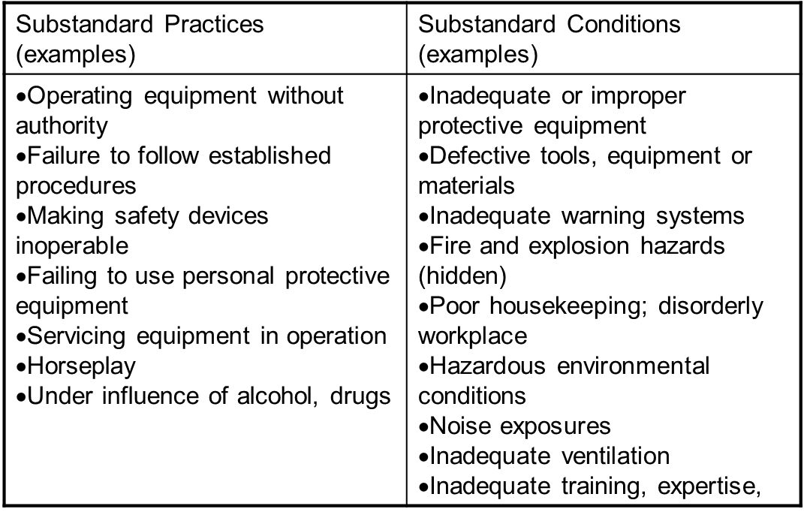
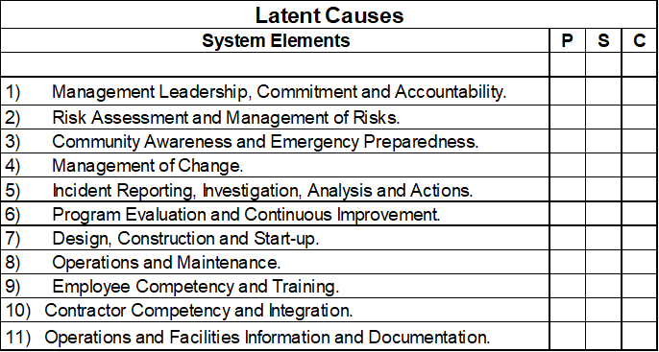
Why Apply the Principles of Human Motivation to Lead Safety?
Leaders must deal with people when people fail to fulfil their roles.
People have responsibilities and must be held accountable.
So, how do we address people problems?
Responsible leaders must start with sub-standard work practices (the immediate cause of a potential or an actual incident) AND must take the necessary steps to identify and address the latent causes.
From the Cause and Effect Model:
Chapter 7.4: Applying the Principles of Human Motivation

Slide 16
Why Apply the Principles of Human Motivation to Lead Safety?
Incidents have basic causes that are directly related to behaviour and motivation; thus addressing these issues is an imperative for improved performance:
… and the need to find the latent causes, NOT terminate the employee!
Chapter 7.4: Applying the Principles of Human Motivation

Slide 17
Management Models:
How are outcomes and behaviours related?
Outcomes are the result of our behaviours ...
Outcomes, whether unwanted or desired, are simply a result of behaviours!
Chapter 7.4: Applying the Principles of Human Motivation
Notes:
17

Slide 18
Management Models:
Three models (as numbered in the textbook) will equip and enable us to effectively modify and manage behaviours, motivate people, and thus achieve the desired outcomes:
Model 1: The Attitudes Model
Model 3: The ABC Model - How Antecedents and Consequences Affect or Influence the Behaviours of Team Members
Model 5: The Abilities Model - How Training and Learning Cycles Shape Behaviours
Model 5)
Model 3)
Model 1)
Chapter 7.4: Applying the Principles of Human Motivation
Notes:
18

Slide 19
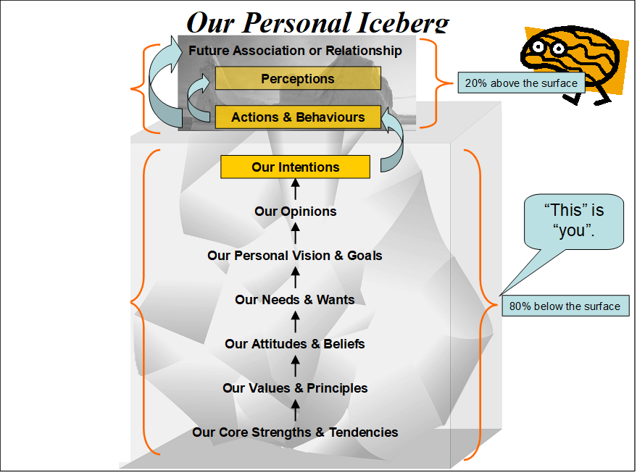
Management Model 1: How Attitudes Shape Behaviours:
Our behaviours are also based on our attitudes.
Understanding and influencing attitudes will set the basis for and drive desirable behaviours and positive outcomes, and help to prevent the unwanted / negative / undesirable outcomes.
Outcomes
So, to influence behaviours, we need to understand how to influence attitudes.
Example: Corporate values to set direction for an organization’s culture, but will not necessarily influence personal values.
Shortcoming: Difficult to influence an individual’s attitudes.
Behaviours
Attitudes
The Attitudes Model, “Our Personal Iceberg”
Chapter 7.4: Applying the Principles of Human Motivation
Notes:
19

Slide 20
Management Model 3: The ABC Model
Outcomes
Behaviours
Antecedents Consequences
By setting antecedents or by applying consequences, we move from understanding behaviour … to influencing behaviour.
… and we achieve desired outcomes and prevent the unwanted outcomes!
Chapter 7.4: Applying the Principles of Human Motivation
Notes:
20

Slide 21
Management Model 3: The ABC Model
1) Future behaviours are influenced by antecedents that set the stage for our actions i.e. prior knowledge of reward or punishment
Outcomes
Behaviours
Antecedents Consequences
Chapter 7.4: Applying the Principles of Human Motivation
Notes:
21

Slide 22
Management Model 3: The ABC Model
Outcomes
Behaviours
Antecedents Consequences
2) Future behaviours are also influenced by the consequences and outcomes of our actions i.e. feedback on past behaviours & outcomes.
Chapter 7.4: Applying the Principles of Human Motivation
Notes:
22

Slide 23
Management Model 3: The ABC Model
Encourage desirable behaviours
Incr
Incr
Incr
Incr
ease Behaviour
ease Behaviour
ease Behaviour
positive
Consequence
Consequence
Consequence
Antecedents Behaviours
Consequence
Antecedents Behaviours
Antecedents Behaviours
Antecedents
Behaviours
DO’s
DON’T’s
negative
Antecedents:
Straight-forward; happen before the behaviour; set the stage for the behaviour
Expectations are set
Creates a positive environment
Intended to positively affect behaviours
Fewer negative outcomes & negative consequences.
Decr
Decr
Decr
Decr
ease Behaviour
ease Behaviour
ease Behaviour
Discourage non
ease Behaviour
-
desirable behaviours
Chapter 7.4: Applying the Principles of Human Motivation
Notes:
23

Slide 24
Management Model 3: The ABC Model
POSITIVE CONSEQUENCE: commend for & to encourage ACCEPTABLE or DESIRABLE behaviours
Encourage desirable behaviours
Incr
Incr
Incr
Incr
ease Behaviour
ease Behaviour
ease Behaviour
positive
Consequence
Consequence
Consequence
Antecedents Behaviours
Consequence
Antecedents Behaviours
Antecedents Behaviours
Antecedents
Behaviours
negative
NEGATIVE CONSEQUENCE: correct for & to discourage UNACCEPTABLE or UNDESIRABLE behaviours
Decr
Decr
Decr
Decr
ease Behaviour
ease Behaviour
ease Behaviour
Discourage non
ease Behaviour
-
desirable behaviours
Consequences:
Happen after and as a result of the behaviour
Feedback on a person’s behaviour
Influence future behaviours
Two examples: positive and negative
Chapter 7.4: Applying the Principles of Human Motivation
Notes:
24

Slide 25
Management Model 3: The ABC Model
POSITIVE CONSEQUENCE: commend for & to encourage ACCEPTABLE or DESIRABLE behaviours
Encourage desirable behaviours
Incr
Incr
Incr
Incr
ease Behaviour
ease Behaviour
ease Behaviour
positive
Consequence
Consequence
Consequence
Antecedents Behaviours
Consequence
Antecedents Behaviours
Antecedents Behaviours
Antecedents
Behaviours
DO’s
DON’T’s
negative
Antecedents:
Straight-forward; happen before the behaviour; set the stage for the behaviour
Expectations are set
Creates a positive environment
Intended to positively affect behaviours
Fewer negative outcomes & negative consequences.
NEGATIVE CONSEQUENCE: correct for & to discourage UNACCEPTABLE or UNDESIRABLE behaviours
Decr
Decr
Decr
Decr
ease Behaviour
ease Behaviour
ease Behaviour
Discourage non
ease Behaviour
-
desirable behaviours
Consequences:
Happen after and as a result of the behaviour
Feedback on a person’s behaviour
Influence future behaviours
Two examples: positive and negative
Chapter 7.4: Applying the Principles of Human Motivation
Notes:
25

Slide 26


Management Model 3: The ABC Model
Three DIMENSIONS in this model:
POSITIVE or NEGATIVE
IMMEDIATE or DELAYED
CERTAIN or UNCERTAIN
Lots of different combinations: PIC, PDC, PDU, NIC, etc.
Not all dimensions and pairs are effective!
PAIRS | EFFECTIVE?
PIC
NIC
ALL OTHERS
Chapter 7.4: Applying the Principles of Human Motivation
Notes:
26

Slide 27
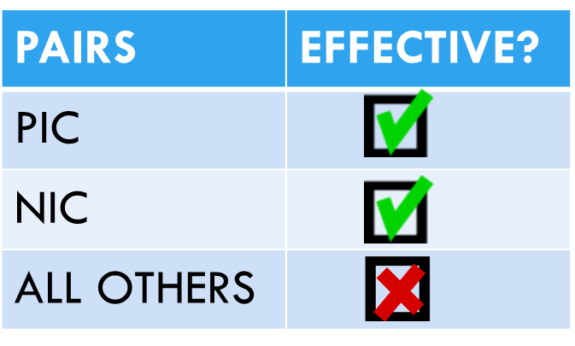
Model 2: Line Management and Model 3: The ABC Model:
ABC Model has 3 DIMENSIONS:
1) POSITIVE or NEGATIVE
2) IMMEDIATE or DELAYED 3) CERTAIN or UNCERTAIN
Please confer & note your answers: (No MM)
Let’s examine how to motivate someone to do something that needs to be done.
Consider this scenario: “I want my employees to report unacceptable conditions.”
Select the CONSEQUENCE of the behaviour that will most effectively encourage the worker to report unacceptable conditions? Identify the Pair Type?
CONSEQUENCE | Most Effective | Pair Type
Worker submits a report; gets a ball cap |  | PIC
Worker submits a report; is asked to come back next week for the ball cap |  | PDC
Worker saw a co-worker get a ball cap, and submits; but the Worker gets a brief, curt “Thanks” instead |  | PIU
Worker walked past a real hazard, did not correct or report, and was observed; next day, the supervisor coaches the Worker |  | NDC
Worker walked past a real hazard, did not correct or report, and was observed; immediately, the supervisor coaches the Worker |  | NIC
Chapter 7.4: Applying the Principles of Human Motivation

Slide 28
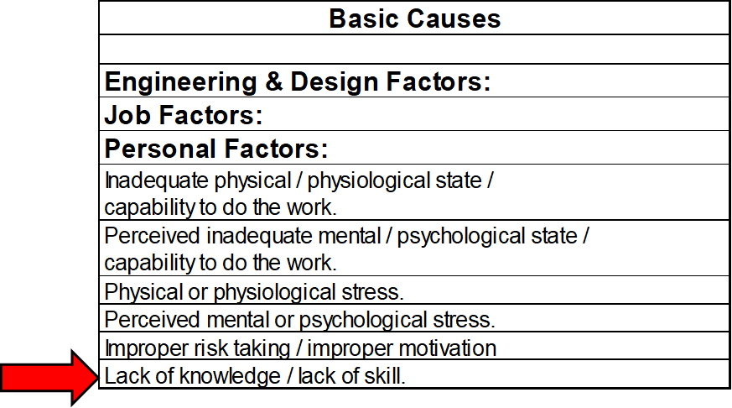
Management Model 5: Abilities – the Training Model
Outcomes
Abilities
(Training)
Behaviours
Our behaviours are also based on our abilities.
We can readily see how abilities through training set the basis for and drive desirable behaviours and positive outcomes, and help to prevent the unwanted / negative / undesirable outcomes.
Chapter 7.4: Applying the Principles of Human Motivation
Notes:
28

Slide 29
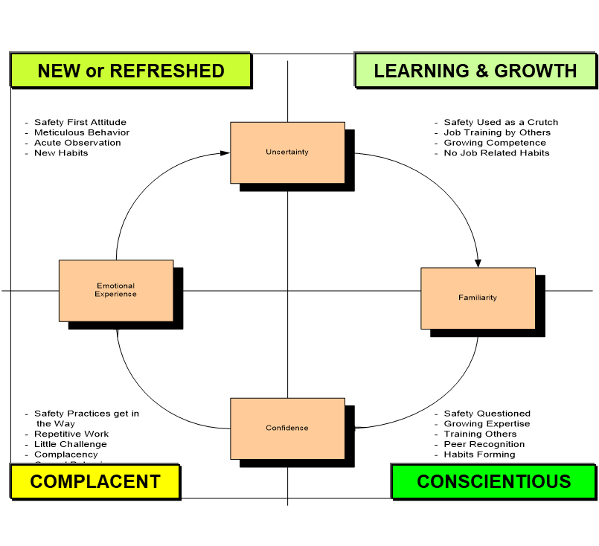
Management Model 5: Abilities – the Training Model
How Training and Learning Cycles Shape Behaviours
The progression of a person in their role or job, can be modeled on the Learning Cycle composed of four quadrants:
New (or Refreshed)
Learning and Growth
Conscientious
Complacent
Chapter 7.4: Applying the Principles of Human Motivation
Notes:
29

Slide 30
Management Model 5: Abilities – the Training Model
New on the job
NEW or REFRESHED
LEARNING & GROWTH
Uncertainty
Emotional Experience
Familiarity
Confidence
COMPLACENT
CONSCIENTIOUS
Chapter 7.4: Applying the Principles of Human Motivation
Notes:
30

Slide 31
Management Model 5: Abilities – the Training Model
NEW or REFRESHED
LEARNING & GROWTH
Uncertainty
HOLY C#@*!
A Trap in the Making?
What is the “Trap”?
Why is there a “Trap”?
What can you do to avoid the “Trap”?
Emotional Experience
Familiarity
Confidence
COMPLACENT
CONSCIENTIOUS
Chapter 7.4: Applying the Principles of Human Motivation
Notes:
31

Slide 32
Management Model 5: Abilities – the Training Model
NEW or REFRESHED
LEARNING & GROWTH
Refresher Training, Management Follow-up, Employee Engagement
Uncertainty
Emotional Experience
Familiarity
DON’T GO HERE!
Confidence
COMPLACENT
CONSCIENTIOUS
Chapter 7.4: Applying the Principles of Human Motivation
Notes:
32

Slide 33
Management Model 5: Abilities – the Training Model
Training reinforces the desirable behaviours:
The effects of repetitive learning opportunities (refresher training): Why is it so effective?
“Sharpen the saw”.
High
Initial Learning Opportunity
With Repetitive Learning Opportunities
Response Skills
With No Additional Learning Opportunities
Low
Time (Vertical Arrows Represent Learning Opportunities)
Chapter 7.4: Applying the Principles of Human Motivation

Slide 34
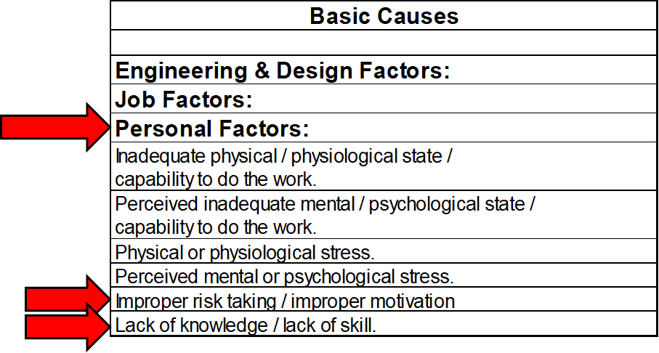
Summary:
Behaviours can lead to human error. Human error constitutes a significant threat to safety and risk management in any industry.
Basic principles and practices of human motivation theories can aid in influencing human behaviours to minimize human error and achieve safe work places.
As future leaders, we need to understand what drives behaviours in the workplace so we can influence those behaviours.
Three models to effectively manage behaviours:
The Attitudes Model – “Our Personal Iceberg” Shapes Behaviours
The ABC Model - How A’s & C’s Affect or Influence Behaviours
The Abilities Model - How Training & Learning Shape Behaviours
Recall: We want to equip you with some tools for managing and leading people!
Chapter 7.4: Applying the Principles of Human Motivation

